Slide 1

Bic Vu Capstone
AI Guild Apprentice Program – Mid Point Code Review
Technology Guild Program | 2023

Slide 2
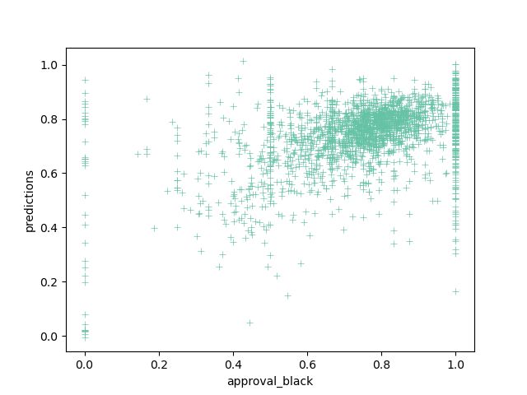



Borrowed Opportunities
Birds of a feather flock together, in social settings, schools, and neighborhoods. How does the social network of a particular neighborhood affect the opportunities of someone looking to buy into that neighborhood?
CHALLENGE
Economic opportunities largely varies depending on where you live and according to a study on social capital* your network of friends. But what is your opportunity of access to these high opportunity neighborhoods? Historically, redlining is the practice of denying borrowers access to credit based on the location of properties, particularly Black borrowers. How could the social network of a particular neighborhood impact the likelihood that a Black borrower be denied a home loan?
IMPACT
While a borrower’s financial portfolio likely is the strongest indicator of loan denial, could the location of a potential home and that neighborhood’s existing social capital be correlated to a borrower’s access? What is does that window of opportunity look like for a Black borrower? How does this prediction compare across redlined neighborhoods?
Initial scatterplot relating black borrower’s approval rate (HMDA) compared to the economic connectedness metric from the Social Capital Study.
Data Sources
Techniques
Technology
Social Capital Atlas
Consumer Financial Protection Bureau (CFPB) Home Mortgage Disclosure Act (HMDA)
Regression model
Model explanation
Pandas
XGBoost
Autogluon
*Social Capital Atlas by Chetty, Jackson, Kuchler, Stroebel, et al. Nature 2022
2

Slide 3

Capstone | Data Pathway
Please show how your data moves from raw to model ready- include any major steps such as feature engineering, grouping, binning, encoding categorical features, PCA, autoencoders, NLP, etc. Be detailed! Add more bubbles!
Filter and aggregate data by census tract
Convert and aggregate categorical data
HMDA data
(home loans)
Feature Engineering
Merge data on census tract
XGBoost
Regression
Review input with SHAP
Model
Social Capital Data
Convert zip to census tract

Slide 4
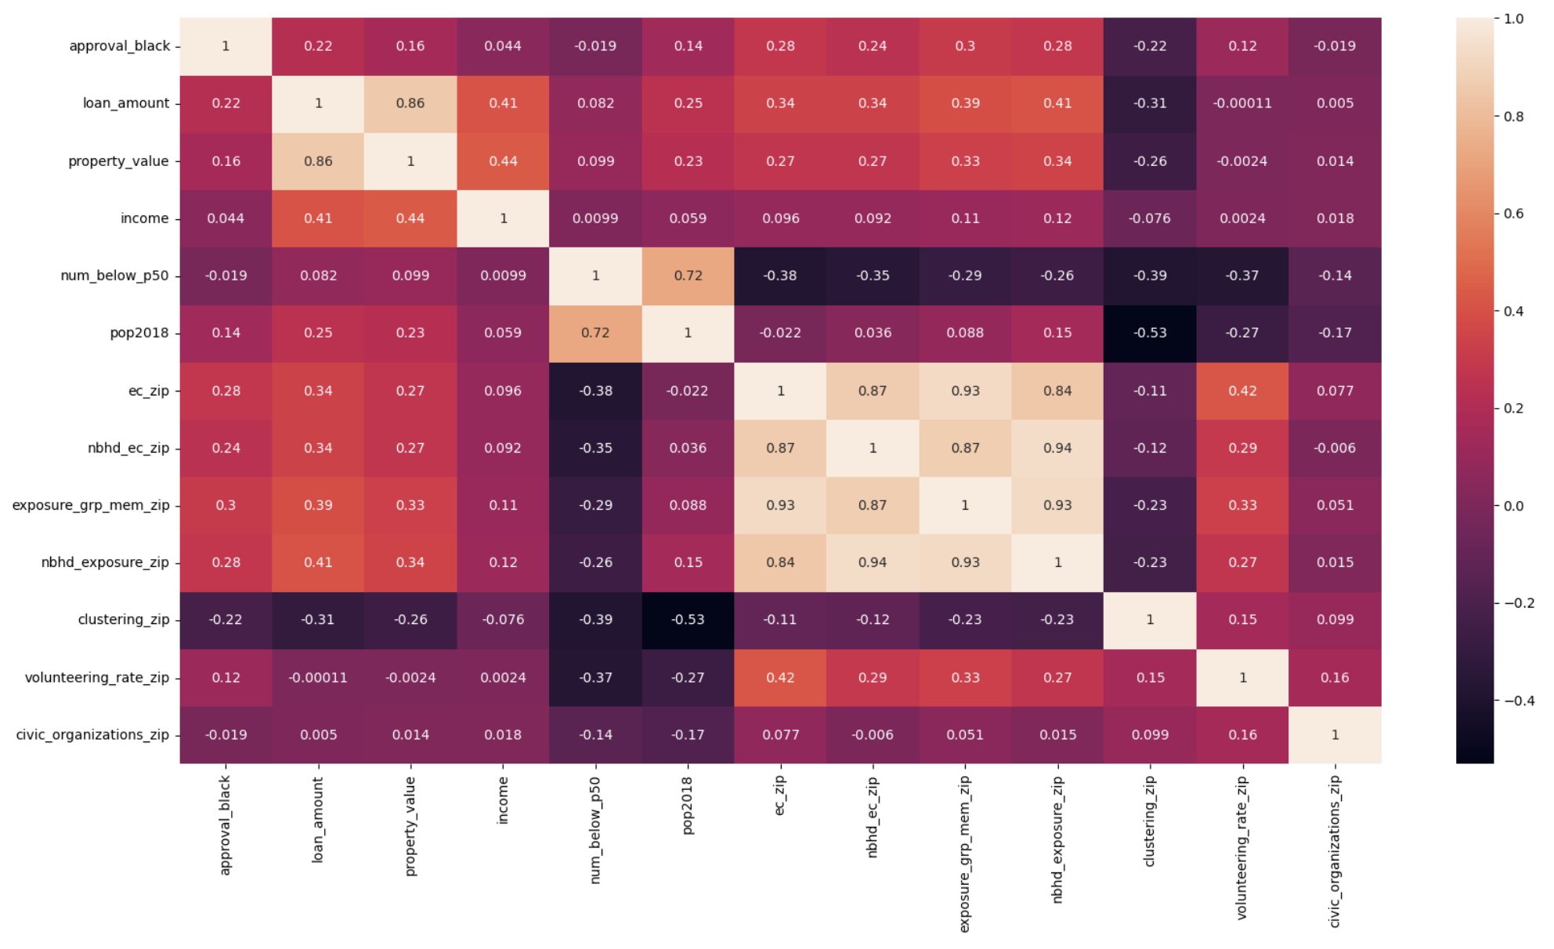
Correlations
Initial review of features correlations
Social Capital
Focus on the correlation between the key metrics in the Social Capital data set and the HMDA data.
HMDA

Slide 5
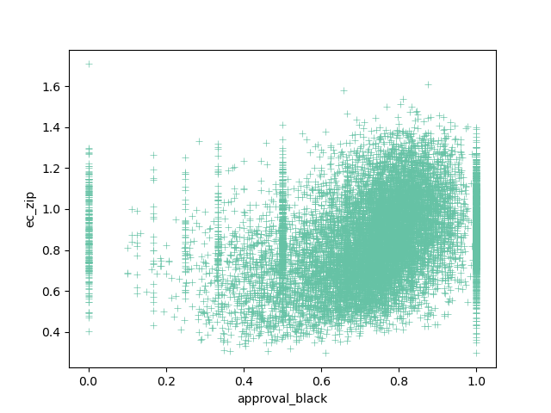
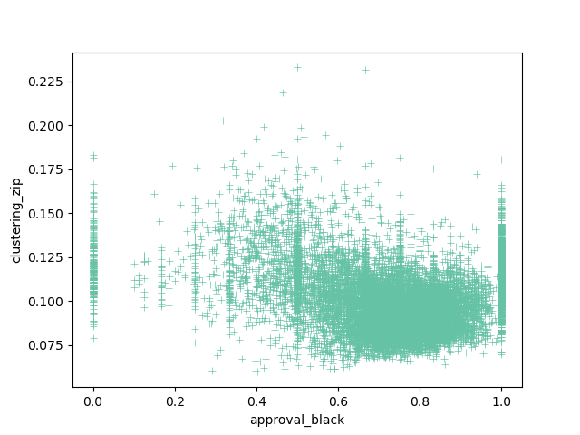
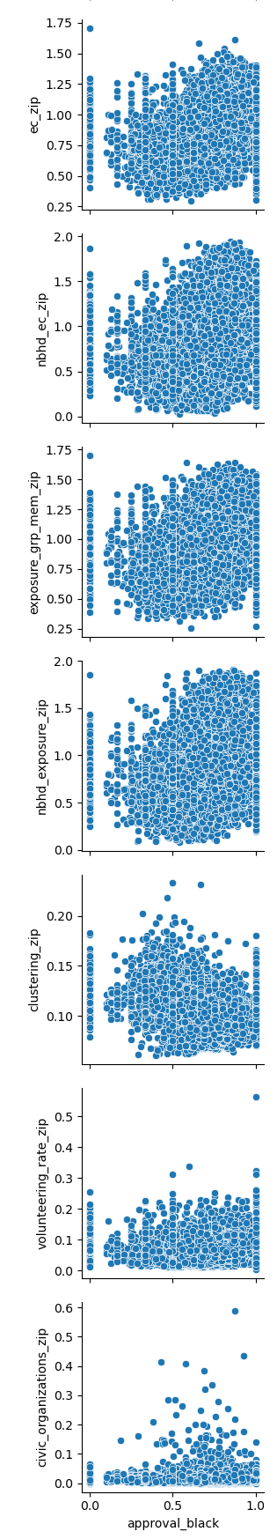
Correlations
Initial review of features correlations
Sample scatter plots between the key metrics in the Social Capital data set and the HMDA data.

Slide 6
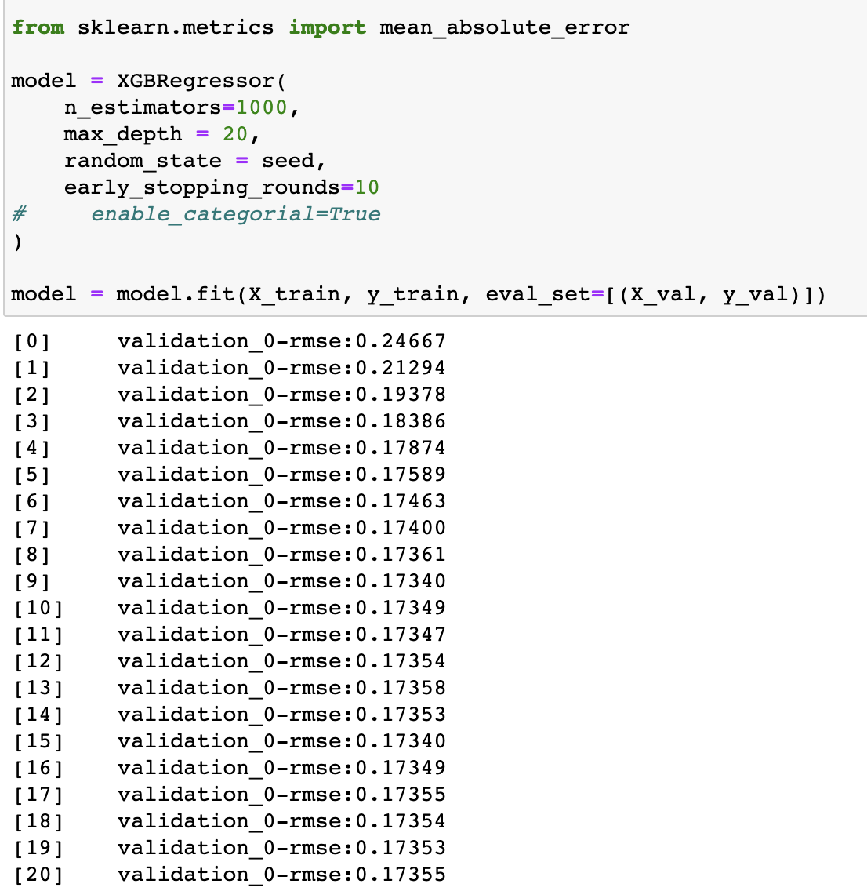
XGBoost Regressor
Regression model with adjusted depth and early stopping.
Comparison of actuals and predictions from XGBoost Regressor model.

Slide 7
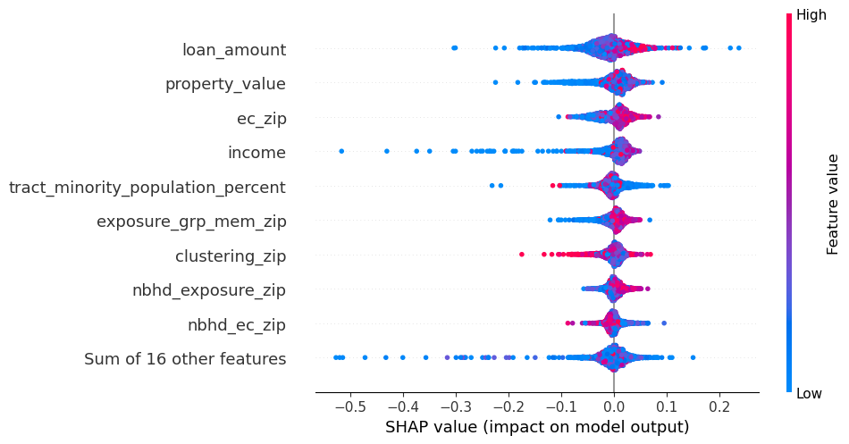
SHAP Feature Importance
Feature impact on model predictions
A number of features have positive impact on the model (high feature value pushes the prediction higher): loan_amount, ec_zip, exposure_grp_mem_zip, nhbd_exposure_zip.
While other strays with extreme feature value either positive or negative: tract_minority_population_percent, clustering_zip

Slide 8
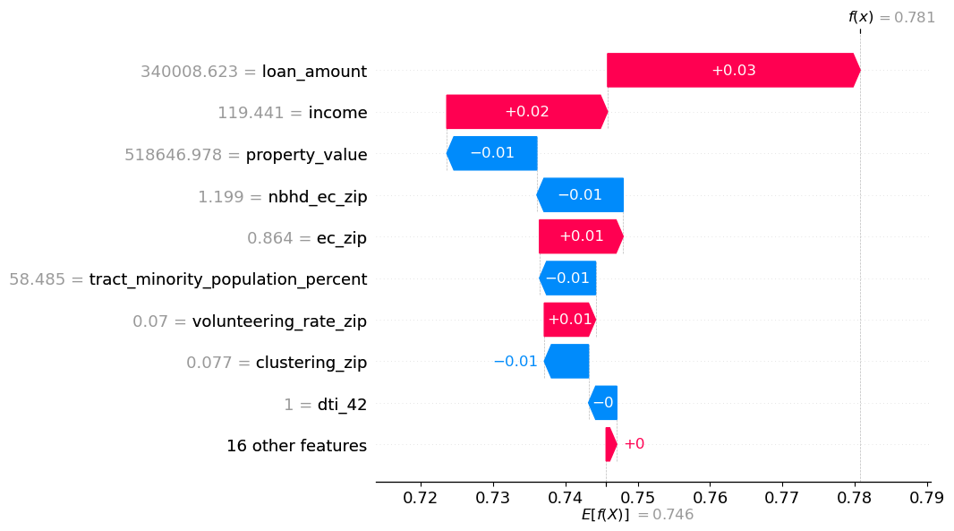
SHAP Feature Importance
Example of one set of input on a predition (probability of home loan approval for a black applicant in a census tract) demonstrating how each input swings the prediction away from the overall prediction.
In this example, the loan_amount pushed the prediction about as high as the property_value, nbhd_ec_zip, and clustering_zip was pushing the prediction down.

Slide 9
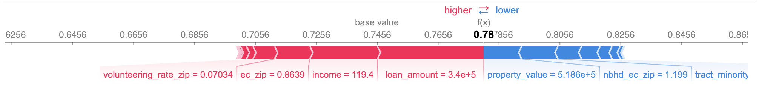
SHAP Feature Importance
Similar force view of how each feature impacts the final prediction.
For this example, there are a number of higher impacting featues pushing the prediction higher.

Slide 10
Capstone | Next Steps
Review feature importance and adjust model
Figure out how categorical data impacts nodel. Encode then unencode?
Bryant/ Reviewer:
Any recommendation for working with categorical data?

Slide 11
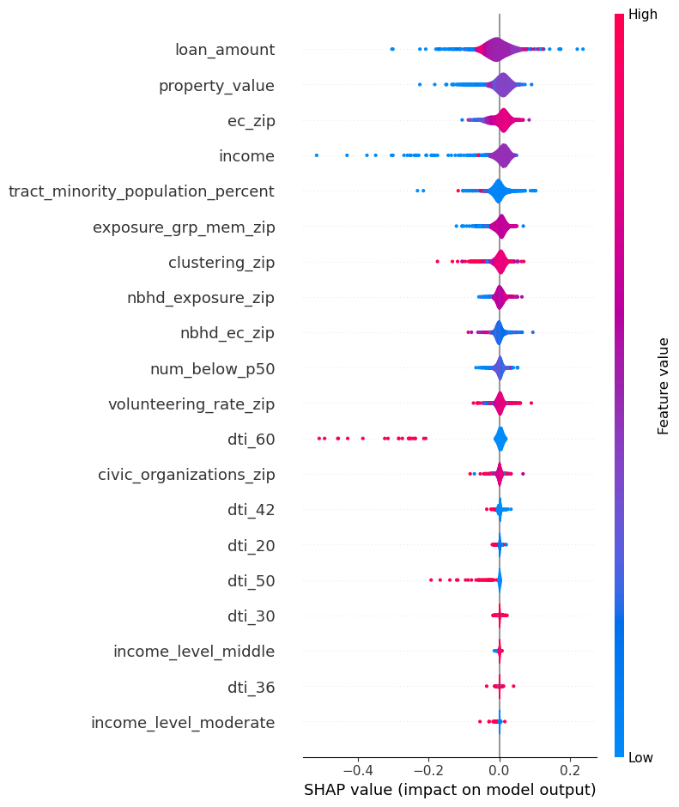
These encoded categories seems funky (Ex: dti_30, dti_50, etc.)

